Slide 1

NAU Mathematics & Statistics Research Showcase
A Centralized Platform for Academic Excellence
Ethan Ferguson | Jack Tomlon | Karl Reger | Rylan Harris-Small
Notes:
[Chris] (Click)
Good afternoon. Today, we are presenting the NAU Mathematics & Statistics Research Showcase, a website designed to transform how the department manages and displays student research.
I’m Karl Reger, and am a member of Team 14, which also consists of Ethan Ferguson, Jack Tomlon, and Rylan Harris-Small. In the next five minutes, we will walk you through the challenges we identified, our proposed solution, and the technical architecture we have developed to address this important need.
Let's begin by understanding the problem.

Slide 2





The Challenge We're Solving
Problem Statement:
The lack of a centralized, structured platform for storing and showcasing Mathematics and Statistics student research affects students, faculty, and external evaluators, resulting in diminished research visibility, ineffective knowledge-sharing, and lost academic and professional opportunities.
Pain Points:
Students: Where is my research stored?
Faculty: How do I find past projects?
External Evaluators: What quality research exists?
Notes:
[Jack] The Mathematics and Statistics Department lacks a centralized, structured platform for storing and showcasing student research. (click) This creates three significant challenges: (click)
First, students struggle to showcase their academic work. After completing excellent research projects, there's no standard way to make them visible to employers or graduate schools, so these projects often end up forgotten or discarded. (click)
Second, faculty cannot easily reference past projects. When advising new students or developing a curriculum, professors have no straightforward way to access the wealth of knowledge created by previous students. (click)
Third, external evaluators such as graduate schools and potential employers have difficulty assessing the department's research output. The impressive work remains largely invisible outside the department without a centralized repository.
The cumulative impact of these challenges is diminished research visibility, ineffective knowledge-sharing, and lost academic and professional opportunities. We've set out to solve this problem.

Slide 3

Our Solution: A Research Showcase Platform
Value Proposition
Unique Advantages
For students, faculty, and external evaluators who need a reliable and structured platform to manage and discover research, the Mathematics & Statistics Research Showcase is a web-based academic repository that streamlines research submission, display, and discovery.
Faculty-driven submission process
Administrative quality control
Advanced search capabilities
Secure role-based access
Notes:
[Ethan] Our solution is the Mathematics & Statistics Research Showcase, a web-based academic repository specifically designed for the department's needs.
(click)
Our value proposition is clear: For students, faculty, and external evaluators who need a reliable and structured platform to manage and discover research, this showcase streamlines the entire process from submission through display to discovery.
(click) Unlike current ad hoc solutions like GitHub repositories or hallway posters, our platform provides four key advantages:
First, a faculty-driven submission process; (click) second, administrative quality control; (click) third, advanced search capabilities that make finding specific research straightforward; (click) and finally, secure role-based access to the platform. (click)
This approach transforms how research is managed, making it accessible while maintaining high academic standards.

Slide 4



The Human Side: Key User Stories
Faculty Story
Administrator Story
Visitor Story
"As a Math Professor, I want to store student capstone projects in a central location so I can reference them easily when advising new students."
"As a department administrator, I want to review research submissions before they go public so we maintain consistent quality standards."
"As a graduate school applicant, I want to search for research by keywords and faculty advisors so I can find projects relevant to my interests."
Notes:
[Ethan] We developed key user stories to ensure our solution addresses real needs that guided our design decisions. These stories represent three of the primary stakeholders in our system.
(click)
From the faculty perspective: 'As a Math Professor, I want to store student capstone projects in a central location so I can reference them easily when advising new students.'
(click)
From the administrator's perspective: 'As a department administrator, I want to review research submissions before they go public so we maintain consistent quality standards
(click)
From the visitor's perspective: 'As a graduate school applicant, I want to search for research by keywords and faculty advisors so I can find projects relevant to my interests.’
These three stories encapsulate the core needs our system addresses, ensuring we build something truly useful for all stakeholders.

Slide 5

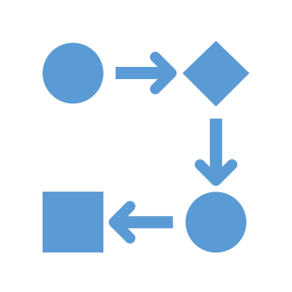


Core Functional Requirements
Faculty Research Submission
Admin Approval Workflow
Role-Based Access Control
Advanced Search & Filtering
Submit metadata & multiple file types
Associate with student authors
Review submissions
Approve, reject, or request revisions
Faculty: submission privileges
Admins: approval authority
Visitors: browsing access
Filter by keyword, category, advisor
Find specific research content quickly
Notes:
[Ethan]
Based on our user stories, we identified four core functional requirements that form the foundation of our system.
(click)
First, the Faculty Research Submission Portal allows professors to submit student research. This creates the entry point for all content in the system.
(click)
Second, the Admin Approval Workflow enables department administrators to review. They can approve, reject, or request specific revisions, ensuring that all published content meets departmental standards.
(click)
Third, Role-Based Access Control enforces appropriate permissions throughout the system. This security model protects the integrity of the research collection.
(click)
Fourth, an Advanced Search and Filtering System allows users to find relevant research using keywords, categories, and advisors.
Together, these requirements create a complete workflow from submission through approval to discovery, addressing all user needs identified in our research.

Slide 6
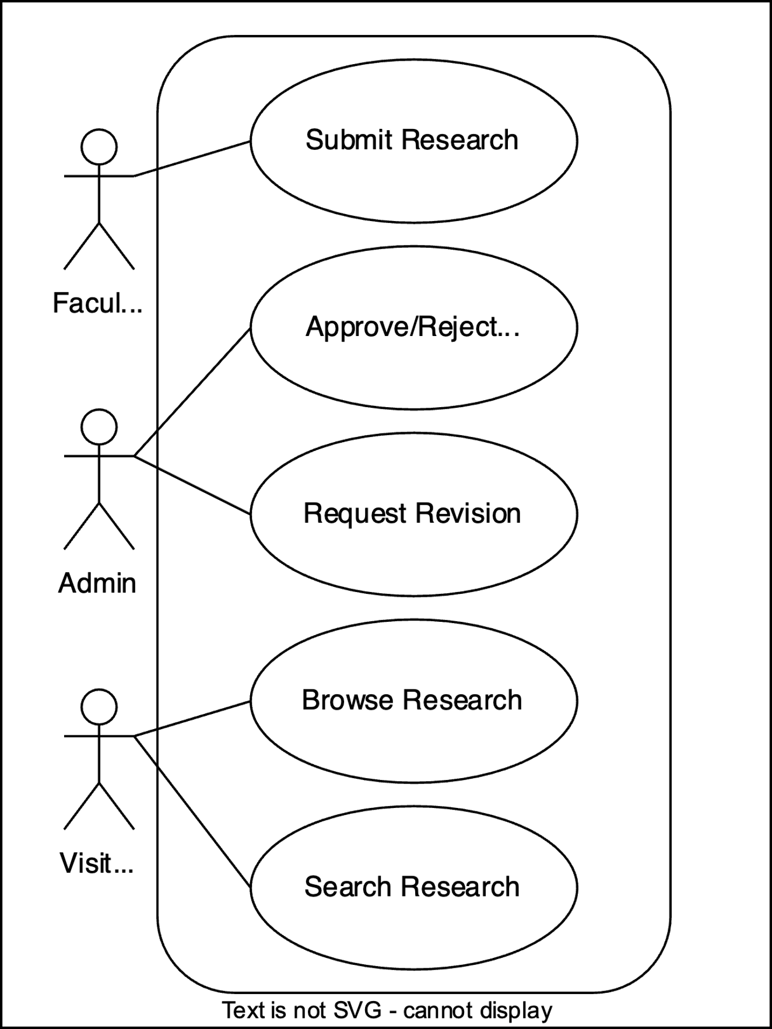
System Interactions: Use Case Diagram
Who are the key actors?
Faculty
Administrators
Visitors
Content contributors
Research mentors
Primary authenticated users
Content gatekeepers
Quality control
System managers
Students seeking examples
Graduate schools evaluating applicants
External collaborators exploring opportunities
Notes:
[Ethan] This UML Use Case diagram offers a visual representation of how various actors interact with our system. The diagram highlights the key interactions between users and the Research Showcase platform.
(click)
Let's examine the three key actors in our system.
(click)
Faculty members contribute content to our system. They serve as research mentors, guiding students through their projects and submitting them to the repository. As primary authenticated users, they possess special permissions to upload content and track its progress status.
(click)
Administrators serve as content gatekeepers, ensuring that only high-quality and appropriate research gets published. They oversee the quality control process and possess the authority to approve, reject, or request submission changes.
(click)
Visitors comprise a diverse group and represent the typical user. They have read-only access to approved content but can utilize all of its searching and browsing capabilities.
These actors' relationships form a complete content lifecycle: faculty create, administrators validate, and visitors consume. This clear separation of responsibilities helps maintain system integrity while effectively serving all stakeholders.

Slide 7
Four Critical System Interactions
Use Case 1: Submit Research
Use Case 2: Approve/Reject Research
Use Case 3: Browse Research
Use Case 4: Search Research
Faculty uploads files and metadata
System validates submission
Content enters the review queue
Admin reviews submission details
Decision made on appropriateness
Notification sent to faculty
Visitors navigate categorized content
System displays approved research
Files and details accessible
Users enter search criteria
System filters database
Relevant results displayed
Notes:
[Ethan] We've identified four critical use cases that represent the core functionality of our system.
(click)
Use Case 1 is Submit Research. (click)
Use Case 2 is Approve/Reject Research.
(click)
Use Case 3 is Browse Research. (click)
Use Case 4 is Search Research.
(click)
These four use cases work together to create a complete research management ecosystem—from contribution through validation to discovery. The submission and approval process ensures quality while browsing and searching enable accessibility.

Slide 8
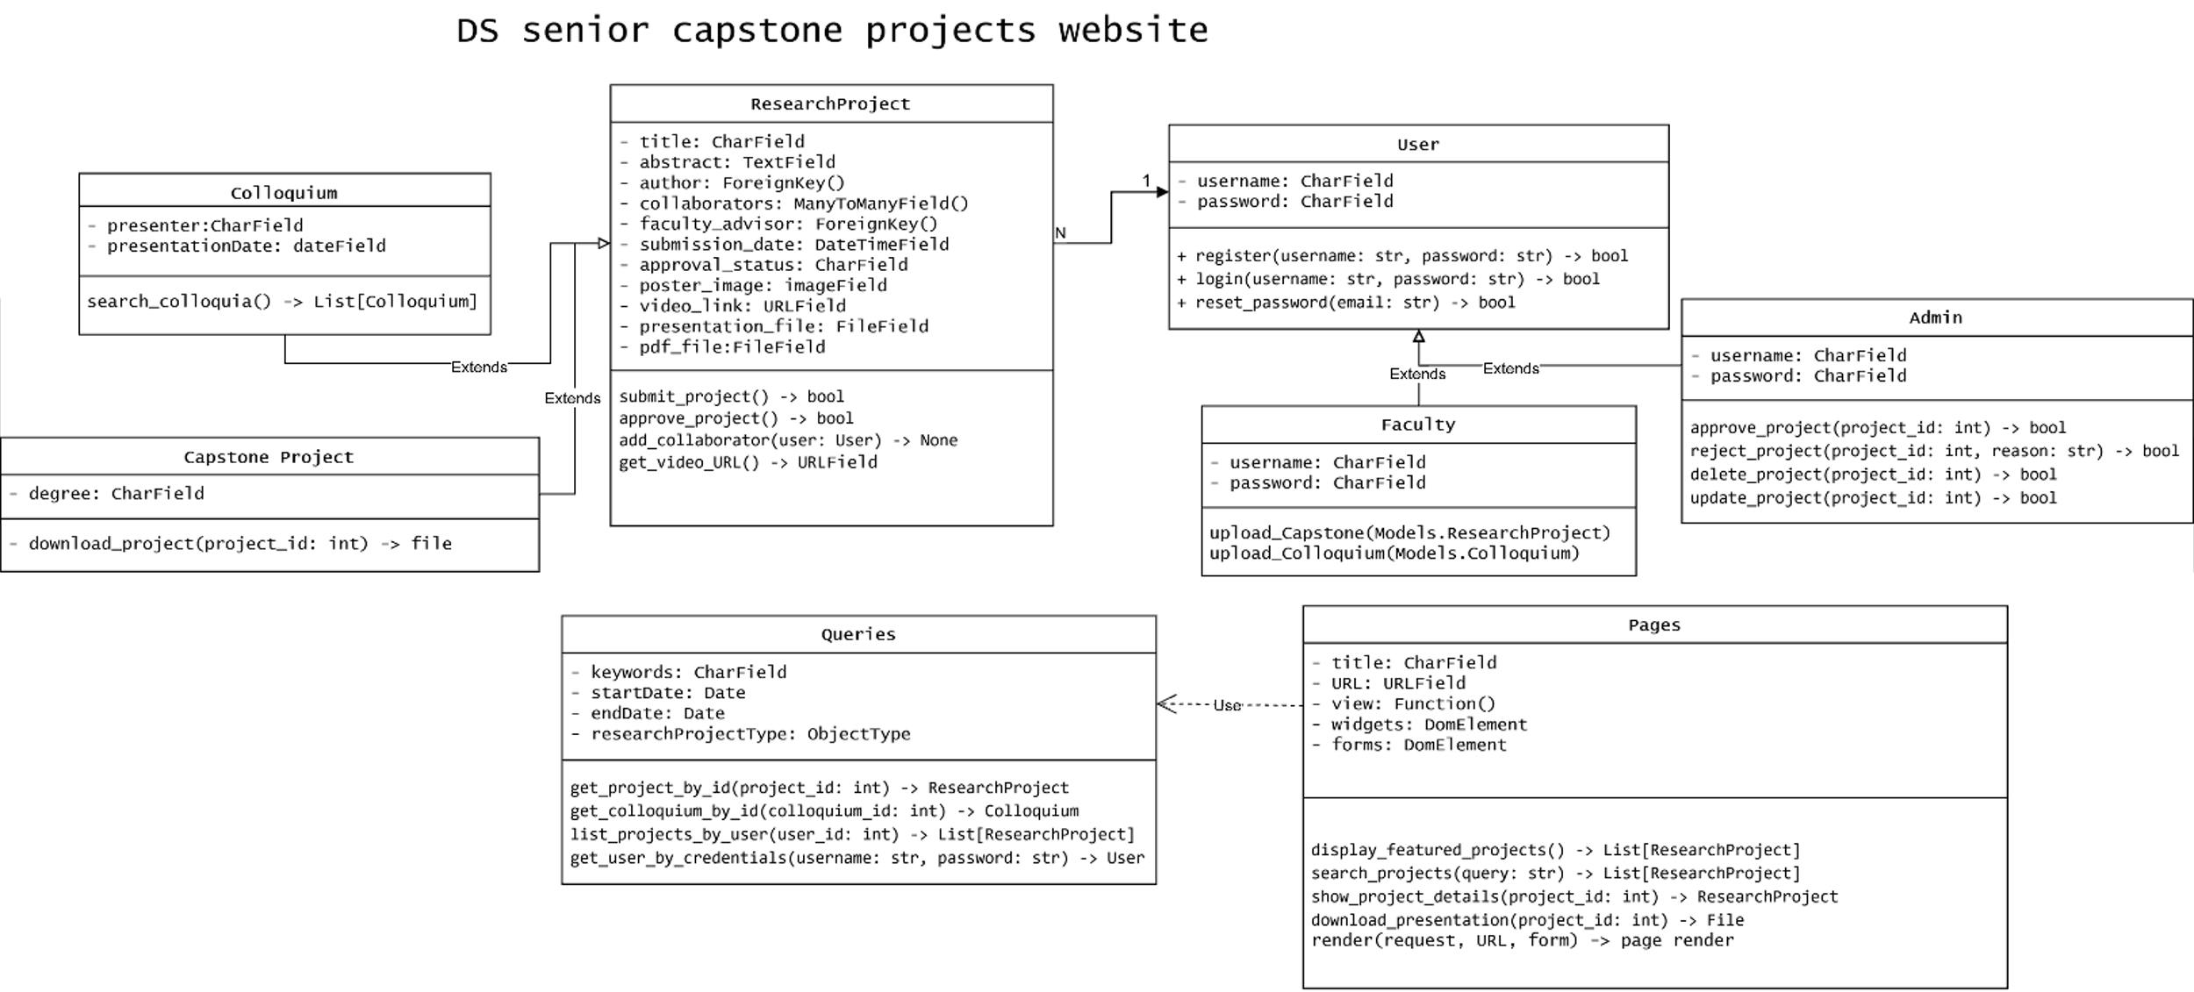
System Architecture: Class Diagram (UML)
PHOTO
Notes:
[Jack] This UML Class diagram illustrates our system's technical architecture. It shows the key data structures and their relationships that power the Research Showcase platform.
The User class, which implements the role-based access control system, is at the center of our architecture. User methods include authentication functions and role verification.
The ResearchProject class is our core data structure, containing attributes such as the title and submission date. It also manages file references for PDFs and images. This class has relationships with the User class—for example a faculty user submits projects.
The Admin class extends User with additional approval methods, while Faculty extends User with submission capabilities. The Colloquium class represents a related but separate content type for the department's speaker series.
The project also utilizes a Pages class to build web pages using our Queries class.
This architecture provides a solid foundation that aligns with our functional requirements while allowing for future expansion as the department's needs evolve.

Slide 9
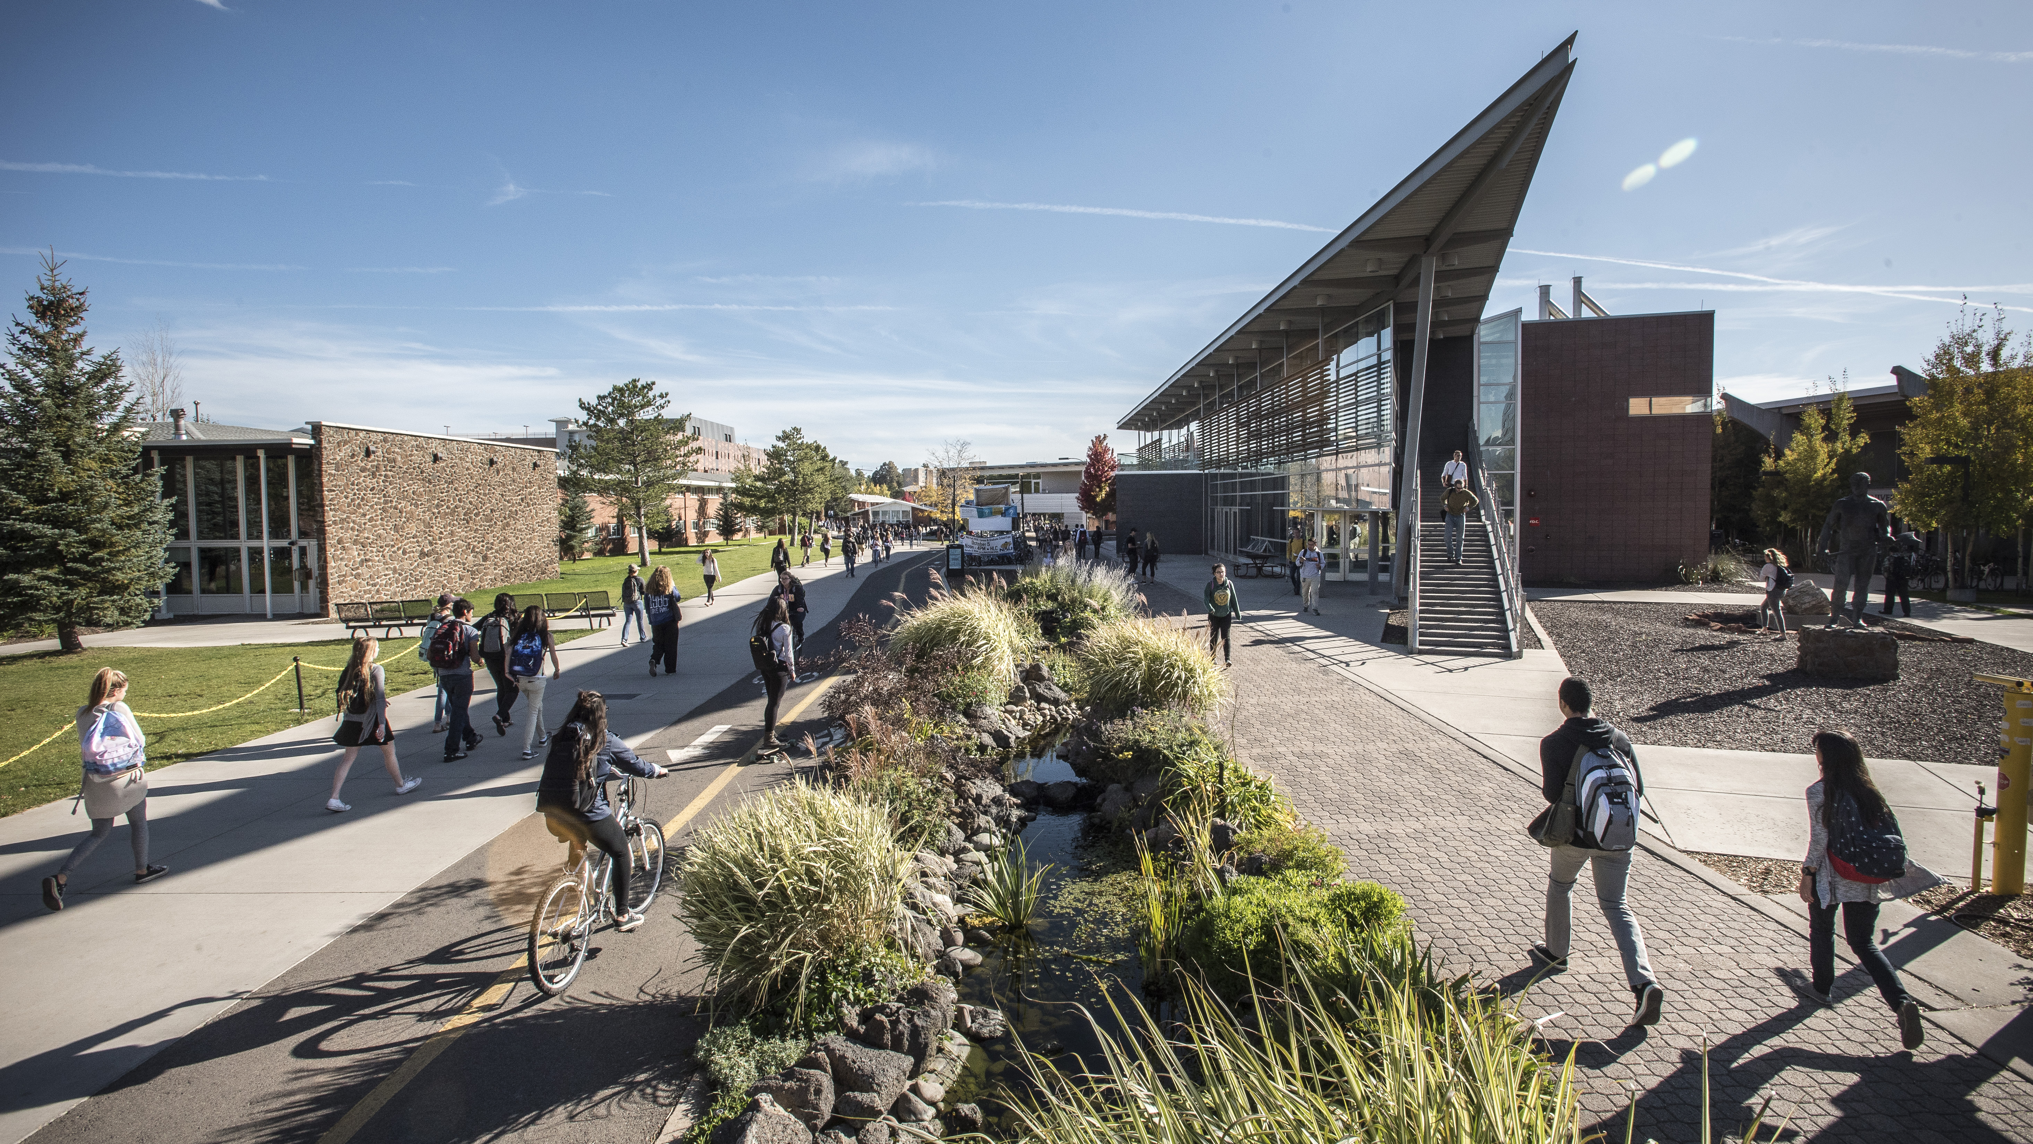
THANK YOU!
Team 14: Ethan Ferguson, Jack Tomlon, Karl Reger, Rylan Harris-Small Repository: github.com/Naalu/ds-senior-capstone-projects-website
Notes:
[Rylan] Thank you for your attention today. We've walked through the Mathematics & Statistics Research Showcase from problem identification through solution design to technical implementation.
To recap: We've created a solution that addresses the department's need for a centralized research repository through a faculty-driven submission process, administrative quality control, role-based access, and powerful search capabilities.
We welcome your questions and feedback as we move forward with this project, and we're excited to be implementing this solution. Thank you.

